Slide 1

Phishing Detection
Paz Levi

Slide 2
Phishing Detection (בעברית - דיוג) - What is it?
Is an attempt to steal sensitive information by impersonating the Internet. The information may include, but is not limited to, usernames and passwords or financial details.
Phishing is done by impersonating a legitimate party who wants to get the information.
The impersonator usually sends an instant message or e-mail in the name of a reputable website, in which the user is asked to click on a link. After clicking on the link, the user arrives at a fake website where he is asked to enter the details that the impostor wants to steal.

Slide 3
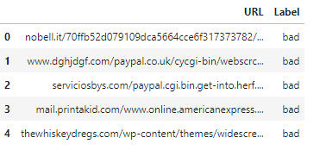
The Dataset:
The data I was based on is taken from the “Kaggle” website Link- https://www.kaggle.com/taruntiwarihp/phishing-site-urls

Slide 4
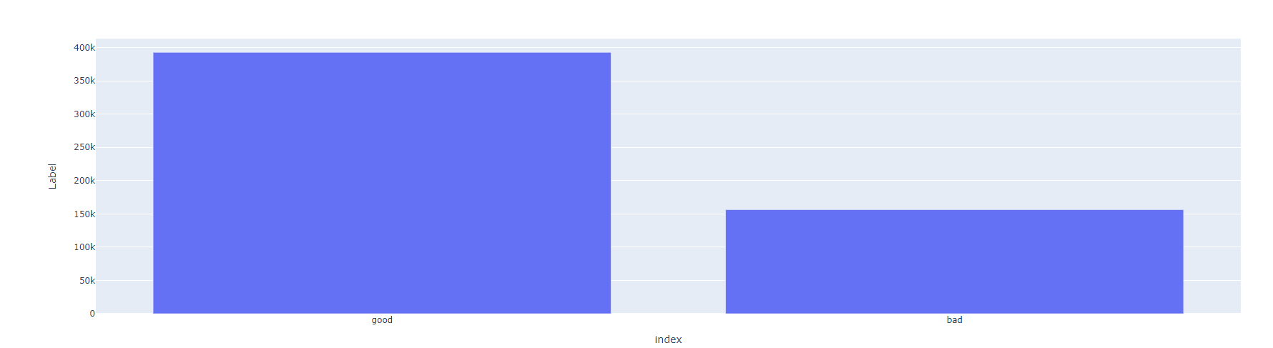
Distribution of the label in the data:

Slide 5
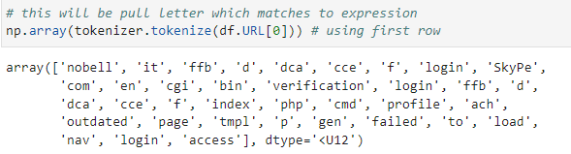
Preprocessing
Now that we have the data, we have to vectorize our URLs. I used CountVectorizer and gather words using tokenizer, since there are words in urls that are more important than other words e.g ‘virus’, ‘.exe’ ,’.dat’ etc. Lets convert the URLs into a vector form.
Before:
After:

Slide 6
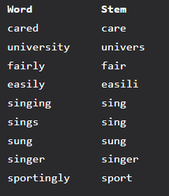
SnowballStemmer:
Snowball is a small string processing language, gives root words

Slide 7
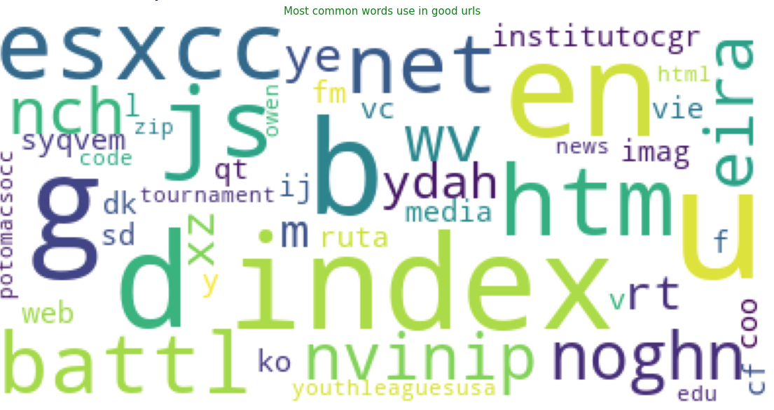
Visualization - Using WordCloud

Slide 8
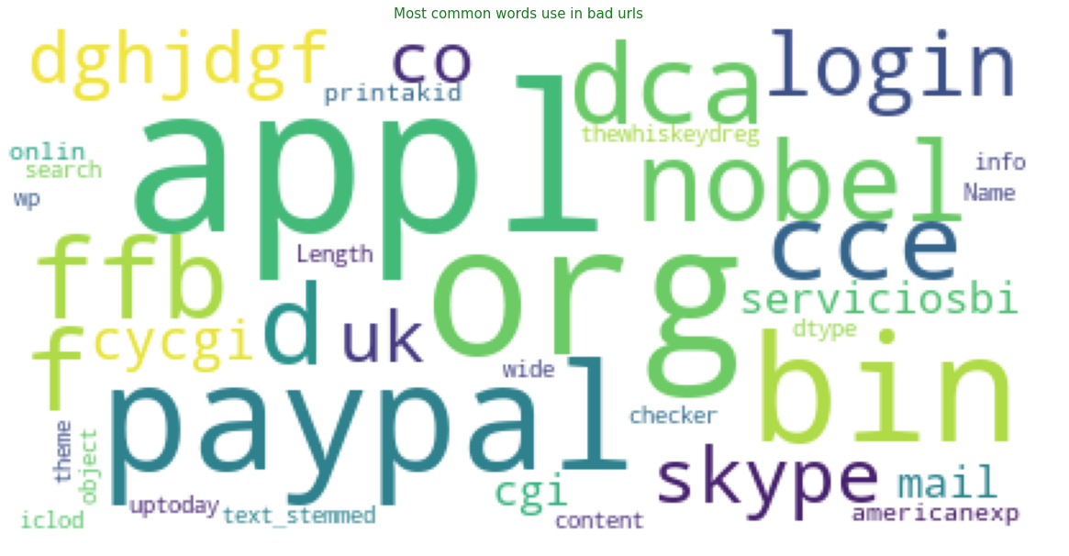
Visualization of the common words on phishing sites

Slide 9
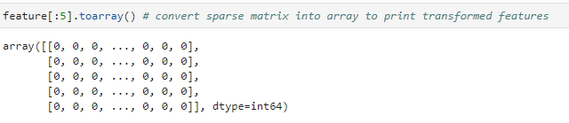
Creating model
Using CountVectorizer -
CountVectorizer is used to transform a corpora of text to a vector of term / token counts.

Slide 10

Spliting the data
The train-test split procedure is used to estimate the performance of machine learning algorithms when they are used to make predictions on data not used to train the model.

Slide 11
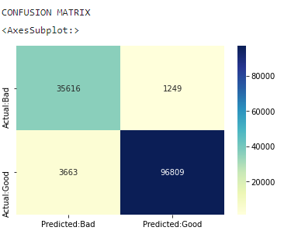
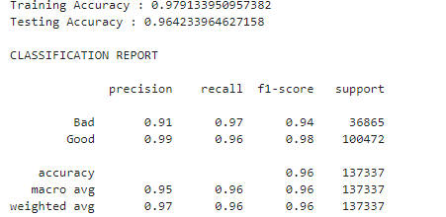
Logistic Regression - Model for training
Logistic regression is a classification algorithm used to find the probability of event success and event failure.
WHY? simple, fast, good results!

Slide 12
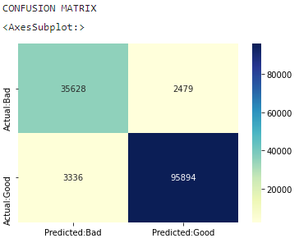
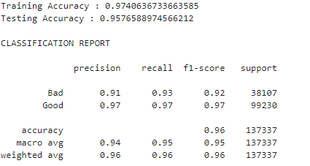
MultinomialNB - Model for training
The multinomial Naive Bayes classifier is suitable for classification with discrete features (e.g., word counts for text classification). The multinomial distribution normally requires integer feature counts.

Slide 13
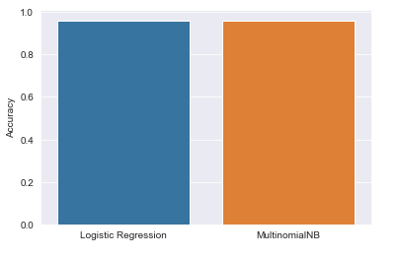

Summary:
As we have seen, Logistics regression is a better model for this problem with an accuracy of almost 97%! (It is important to note that I measured the success of the model by r2 score)

Slide 14
